Slide 1
Pre-Live Session 3
Filtering And Autoregressive Models of Lag 1

Slide 2
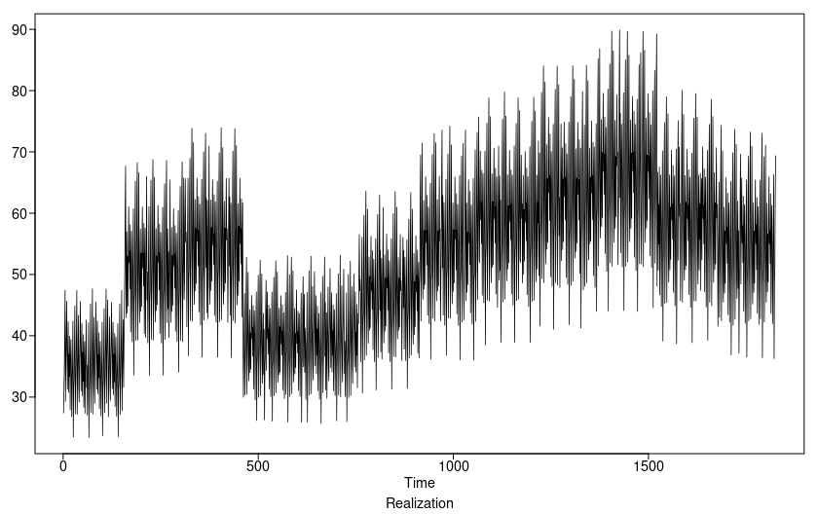
Mean Sales For Item of All Stores

Slide 3
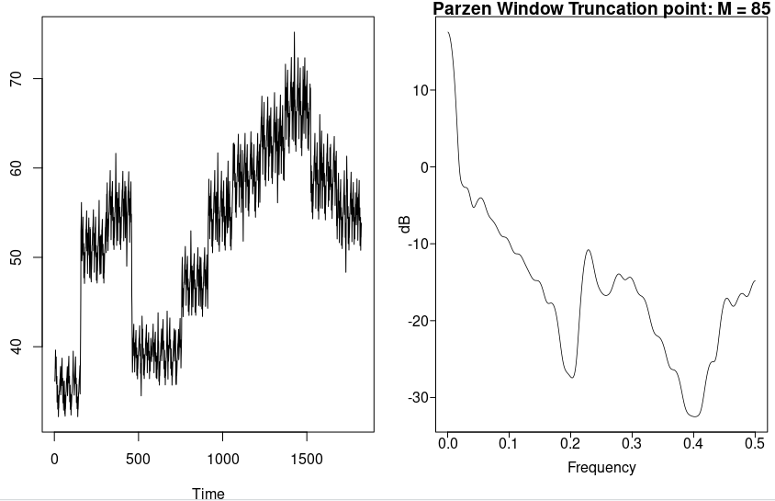
5 point Moving Average
As you can see from the spectral density and the realization the higher frequencies were squeezed out somewhat. The spectral density still shows 2 other peaks that shows that there are still some other higher frequencies available. Hopefully 51 point average can smooth things out.

Slide 4
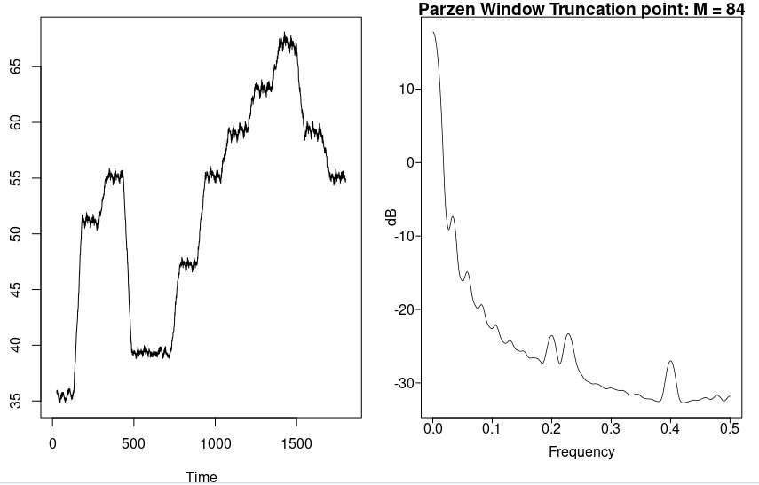
51 point Moving Average
51 point moving average shows a much smoother plot. There are still smaller and refined peaks shown in the spectral density plot. So if the point moving smoother is higher the more it tunes out higher frequencies.

Slide 5
Takeaways
In a complex plane such that abs(z) = 1 the z forms a unit circle. If abs(z) > 1 z is then outside the unit circle.
Autoregessive models tend to be very useful for describing stationary data that move forward in time.
  An AR(1) process is stationary if and only if | | < 1.
There are 2 types of filter:
  Low pass: Pass low frequency behavior and filers out higher frequency behavior.
  High Pass: Pass high frequency behavior and filter out lower frequency behavior.
A GLP is a linear filter with white noise
Conditions 1,2, and 3 for stationary AR(1)
  Expected value = population mean. Mean does not depend on time.
  Variance is finite as long as | | < 1 and it does not depend on time.
  Autocorrelation is dependent on k not time t.
  Spectral density monotonically increasing or decreasing in f depending on

Slide 6
Questions
Asked in Office Hours.

